Slide 1
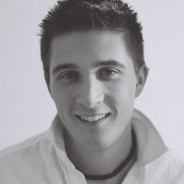
Ryan Morreale M.Ed. Social & Cultural Contexts in Education B.Ed. Adult Education B.A. Human Geography TESL Ontario Member
Office Hours: By Appointment Only
Current Semester’s Courses (Fall 2019)
WRIT 120
WRIT 208
ESOL 120
Ryan.Morreale@humber.ca
Introduction & Creation of P.We.F. Goals (exemplar)

Slide 2
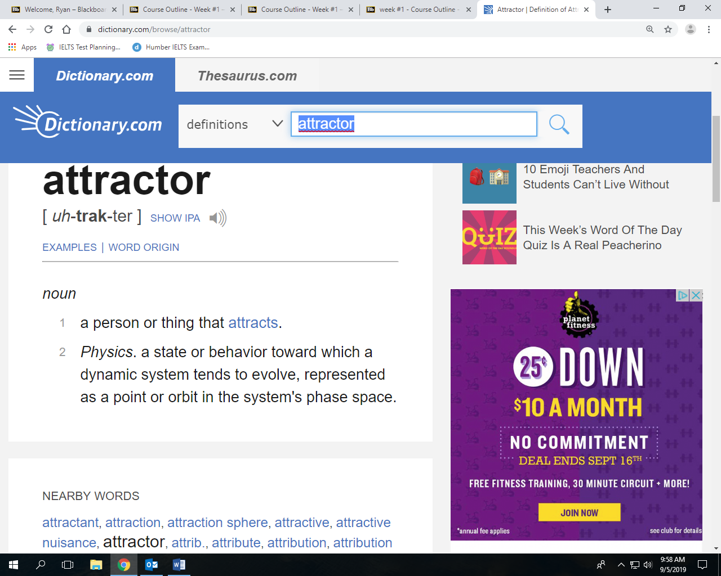

Setting the tone of the Course?!

Slide 3
P.We.F. Goals
Week #1
5% Assignment
PART 1:
P.We.F – setting goals for yourself within personal, work, education and fun areas of your life. Think in contexts of one, three and five/ten years in each area mentioned above. Encouraged to do it via word web/informal writing (we can discuss more in class)

Slide 4
P.We.F. Goals
PART 2:
Below your word-web / diagram of goals / written sections of goals *****DETAILS! ~ Answer these questions in a paragraph.
What do you expect of yourself from this course?
What do you expect of your colleagues from this course?
What do you expect of Ryan from this course?
What three areas within your field of study will you read and write about …what topic area are you: interested in / concerned about / highlighting / exploring
I encourage you to have key words within your sentences to explain number four.

